Slide 1
CSE 460: VLSI Design
Tanvir Ahmed
Lecturer, dept. of cse, brac u
Email: Tanvir.ahmed@bracu.ac.bd

Slide 2

Finite State Machine
A Finite State Machine, or ”FSM” is a computation model that can be used to simulate sequential logic.
In FSM, there can be multiple states that are modelled after real life examples.
FSM circuits are realized using combinational logic and flip-flops.
Transition between states are the controlled by two factors, primary inputs and present state of the flip-flops.
Depends on these two factors we have two types of FSM that we will discuss and simulate.

Slide 3
Finite State Machine
Two types of FSMs are
Moore type FSM
Mealy type FSM
Moore Type FSM : The sequential circuits whose outputs depend only on the states of the
circuit are of Moore type.
Mealy Type FSM : The sequential circuits whose outputs depend on both the state and the
present primary inputs are of Mealy type.

Slide 4
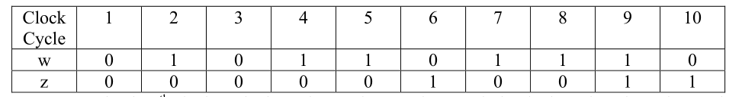
Moore Type FSM
Problem: Suppose that we wish to design a circuit that meets the following specification:
1. The circuit has one input, w, and one output, z.
2. All changes in the circuit occur on the positive edge of a clock signal.
3. The output z is equal to 1 if during two immediately preceding clock cycles the input w was equal to 1. Otherwise, the value of z is equal to 0.
Input-output combination:

Slide 5
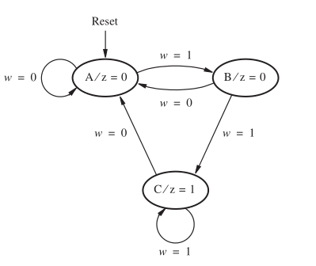
Moore Type FSM
Present State | Next State |  | Output z
 | w=0 | w=1
A | A | B | 0
B | A | C | 0
C | A | C | 1
Figure : State Diagram
Figure : State Table

Slide 6
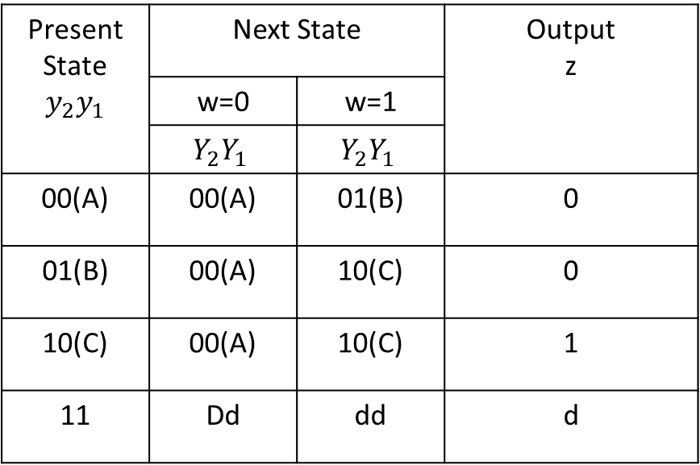
Moore Type FSM
Present State $$y_{2}y_{1}$$ | Next State |  | Output z
 | w=0 | w=1
 | $$Y_{2}Y_{1}$$ | $$Y_{2}Y_{1}$$
00(A) | 00(A) | 01(B) | 0
01(B) | 00(A) | 10(C) | 0
10(C) | 00(A) | 10(C) | 1
11 | Dd | dd | d
Figure : State Diagram

Slide 7
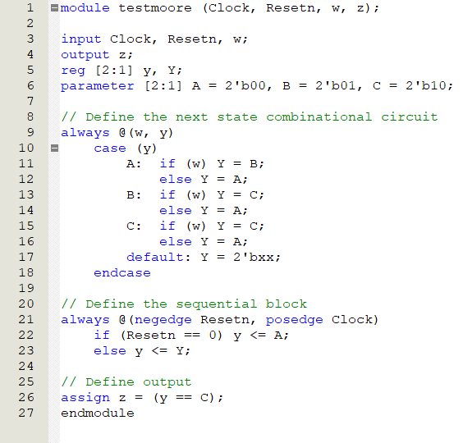
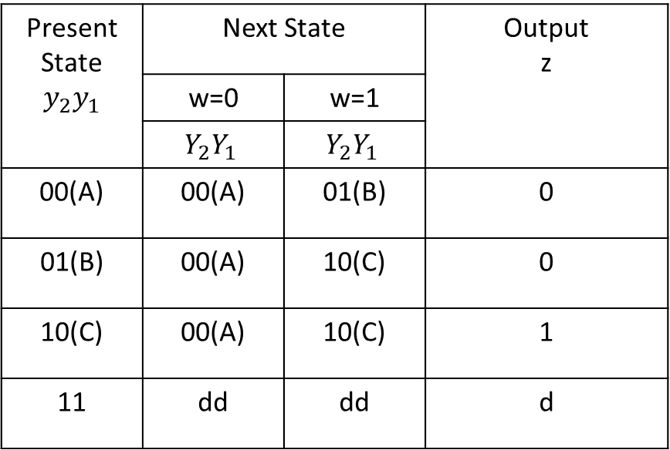
Moore Type FSM
Present State $$y_{2}y_{1}$$ | Next State |  | Output z
 | w=0 | w=1
 | $$Y_{2}Y_{1}$$ | $$Y_{2}Y_{1}$$
00(A) | 00(A) | 01(B) | 0
01(B) | 00(A) | 10(C) | 0
10(C) | 00(A) | 10(C) | 1
11 | dd | dd | d

Slide 8
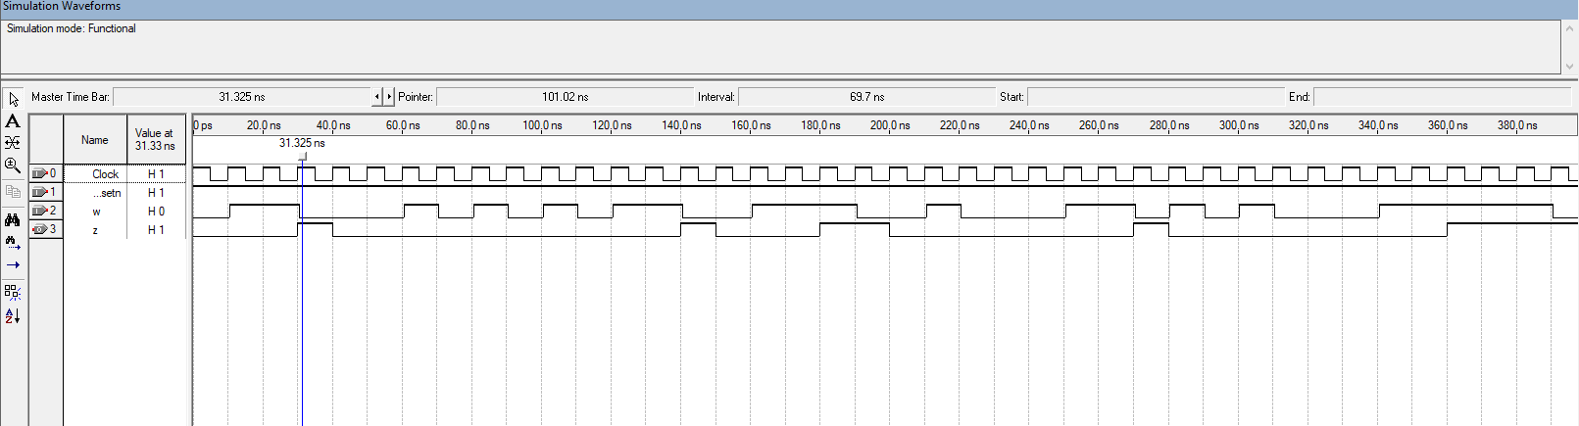
Moore Type FSM

Slide 9
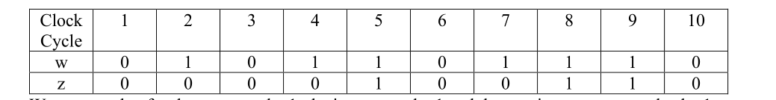
Mealy Type FSM
Problem: Suppose that we wish to design a circuit that meets the following specification:
1. The circuit has one input, w, and one output, z.
2. All changes in the circuit occur on the positive edge of a clock signal.
3. The output z is equal to 1 if during two immediate clock cycles the input w was equal to 1. Otherwise, the value of z is equal to 0.
Input-output combination:

Slide 10
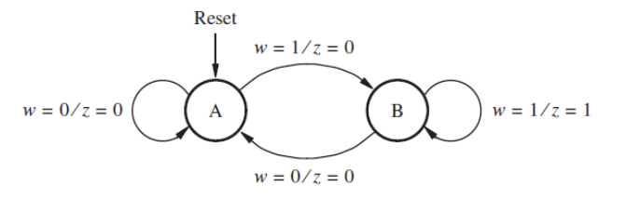
Mealy Type FSM
Figure : State Diagram

Slide 11
Mealy Type FSM
Present State | Next State |  | Output z
 | w=0 | w=1 | w=0 | w=1
A | A | B | 0 | 0
B | A | B | 0 | 1
Present State | Next State |  | Output z
y
 | w=0 | w=1 | w=0 | w=1
 | Y | Y
0(A) | 0(A) | 1(B) | 0 | 0
1(B) | 0(A) | 1(B) | 0 | 1
Figure : State Table
Figure : State-assigned Table

Slide 12
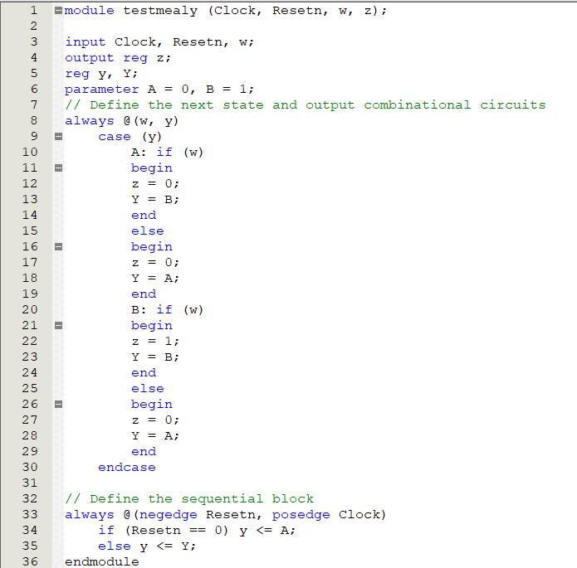
Mealy Type FSM
Present State | Next State |  | Output z
y
 | w=0 | w=1 | w=0 | w=1
 | Y | Y
0(A) | 0(A) | 1(B) | 0 | 0
1(B) | 0(A) | 1(B) | 0 | 1

Slide 13
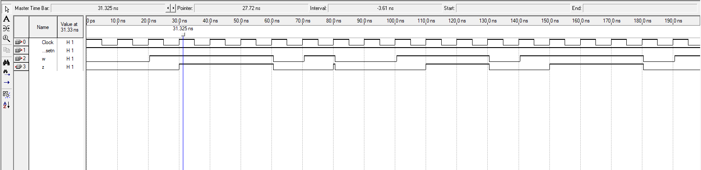
Mealy Type FSM

Slide 14
An Example
Problem: Derive the state diagram for an FSM that has an input w and an output z. The machine has to generate z = 1 when the previous four values of w were 1001 or 1111; otherwise, z = 0.Overlapping input patterns are allowed. An example of the desired behavior is
Clock cycle | 1 | 2 | 3 | 4 | 5 | 6 | 7 | 8 | 9 | 10 | 11 | 12 | 13 | 14 | 15 | 16 | 17
w | 0 | 1 | 0 | 1 | 1 | 1 | 1 | 0 | 0 | 1 | 1 | 0 | 0 | 1 | 1 | 1 | 1
z | 0 | 0 | 0 | 0 | 0 | 0 | 1 | 0 | 0 | 1 | 0 | 0 | 0 | 1 | 0 | 0 | 1

Slide 15
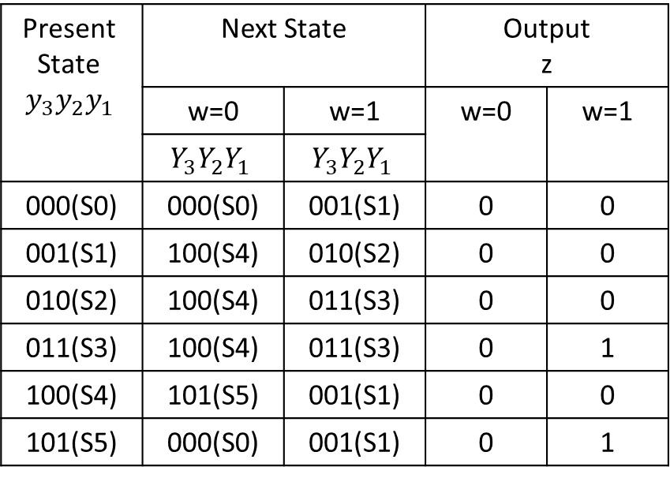
An Example
Present State | Next State |  | Output z
 | w=0 | w=1 | w=0 | w=1
S0 | S0 | S1 | 0 | 0
S1 | S4 | S2 | 0 | 0
S2 | S4 | S3 | 0 | 0
S3 | S4 | S3 | 0 | 1
S4 | S5 | S1 | 0 | 0
S5 | S0 | S1 | 0 | 1
Present State $$y_{3}y_{2}y_{1}$$ | Next State |  | Output z
 | w=0 | w=1 | w=0 | w=1
 | $$Y_{3}Y_{2}Y_{1}$$ | $$Y_{3}Y_{2}Y_{1}$$
000(S0) | 000(S0) | 001(S1) | 0 | 0
001(S1) | 100(S4) | 010(S2) | 0 | 0
010(S2) | 100(S4) | 011(S3) | 0 | 0
011(S3) | 100(S4) | 011(S3) | 0 | 1
100(S4) | 101(S5) | 001(S1) | 0 | 0
101(S5) | 000(S0) | 001(S1) | 0 | 1
Figure : State Table
Figure : State-assigned Table

Slide 16
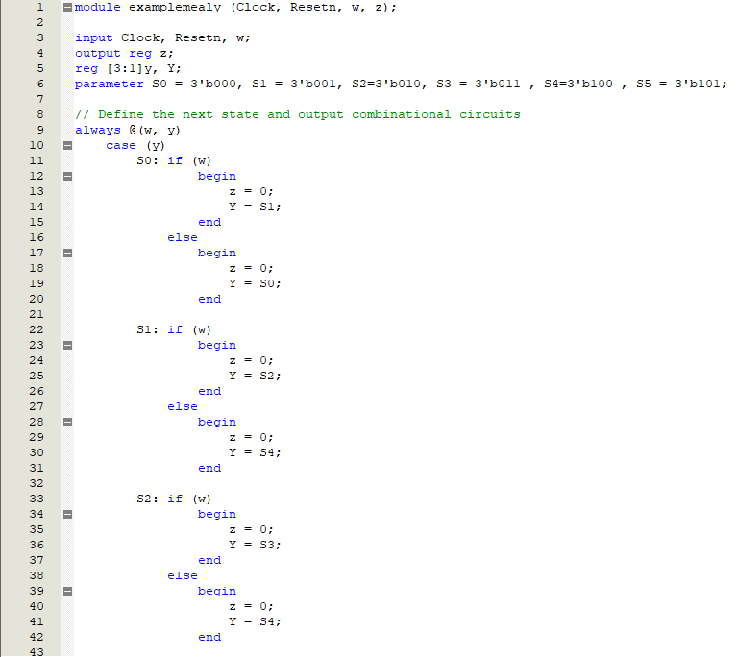
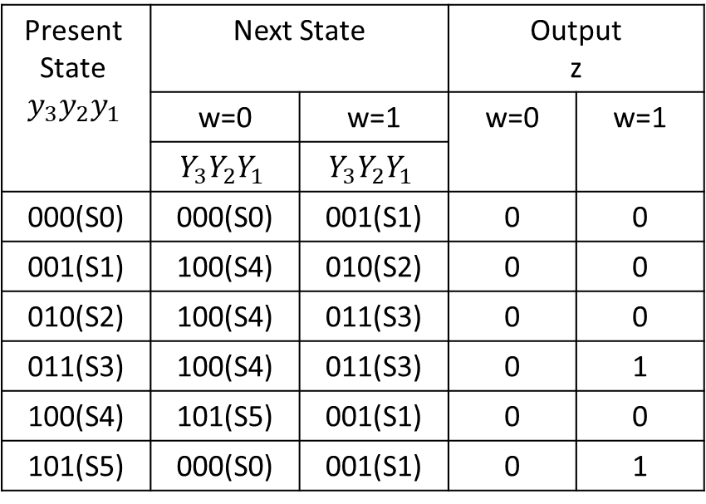
An Example
Present State $$y_{3}y_{2}y_{1}$$ | Next State |  | Output z
 | w=0 | w=1 | w=0 | w=1
 | $$Y_{3}Y_{2}Y_{1}$$ | $$Y_{3}Y_{2}Y_{1}$$
000(S0) | 000(S0) | 001(S1) | 0 | 0
001(S1) | 100(S4) | 010(S2) | 0 | 0
010(S2) | 100(S4) | 011(S3) | 0 | 0
011(S3) | 100(S4) | 011(S3) | 0 | 1
100(S4) | 101(S5) | 001(S1) | 0 | 0
101(S5) | 000(S0) | 001(S1) | 0 | 1
Figure : Verilog code (part 1)
Figure : State-assigned Table
Figure : State-assigned Table

Slide 17
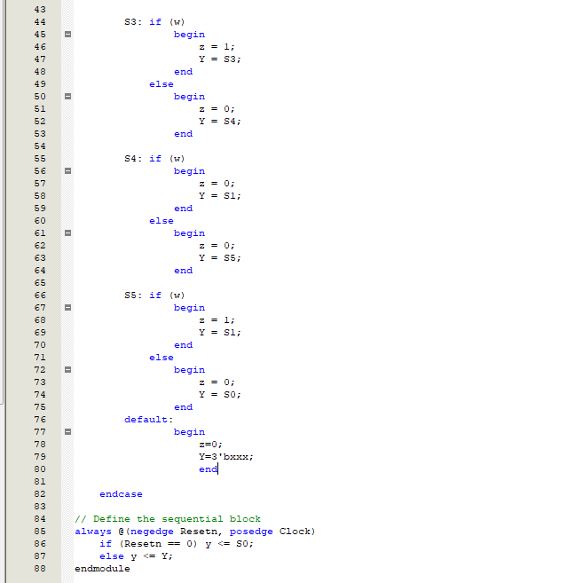
An Example
Present State $$y_{3}y_{2}y_{1}$$ | Next State |  | Output z
 | w=0 | w=1 | w=0 | w=1
 | $$Y_{3}Y_{2}Y_{1}$$ | $$Y_{3}Y_{2}Y_{1}$$
000(S0) | 000(S0) | 001(S1) | 0 | 0
001(S1) | 100(S4) | 010(S2) | 0 | 0
010(S2) | 100(S4) | 011(S3) | 0 | 0
011(S3) | 100(S4) | 011(S3) | 0 | 1
100(S4) | 101(S5) | 001(S1) | 0 | 0
101(S5) | 000(S0) | 001(S1) | 0 | 1
Figure : Verilog code (part 2)
Figure : State-assigned Table

Slide 18
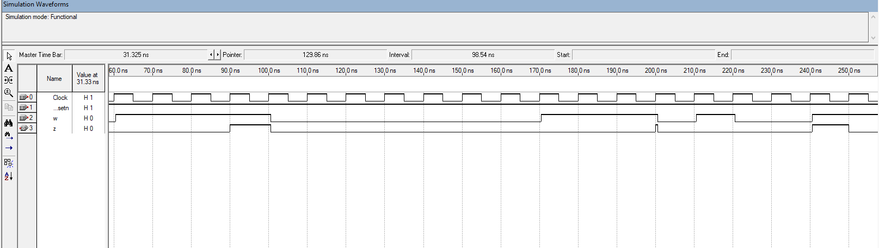
An Example
Figure : Output waveform

